Slide 1
EDL Event Flow Design
Lixin Cheng

Slide 2

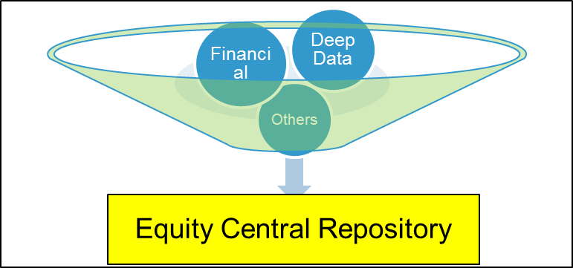
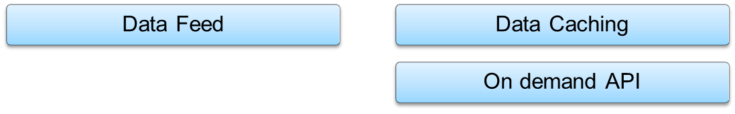
EDL system boundary
EDL

Slide 3
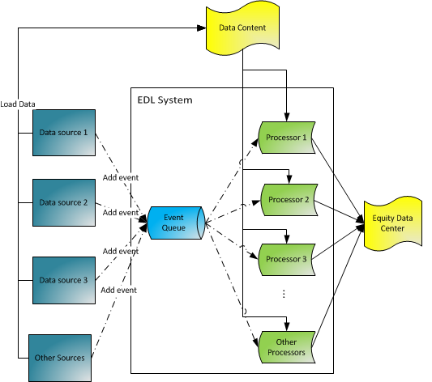
EDL Data Flow

Slide 4
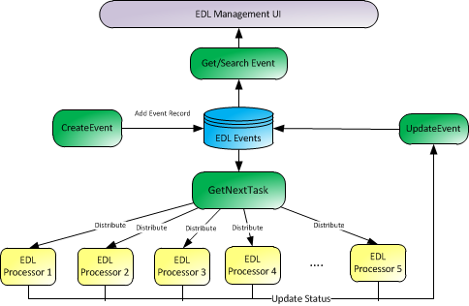
EDL Event Flow

Slide 5
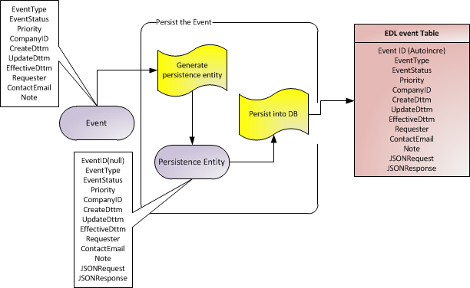
EDL Event Creation
Event producers send request to create event through web service
Event service creates the event request object and serialize to JSON format
The basic event information and JSON format request will be persisted

Slide 6
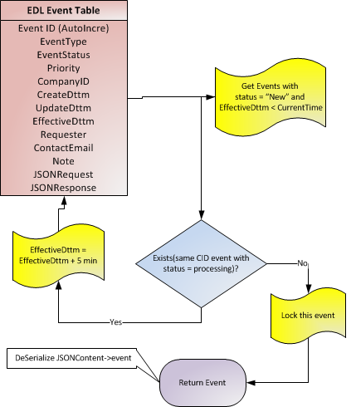
EDL Event Consumption
Get all the unprocessed events based on effective time
Postpone the events for companies with other events under processing
Change the first event’s status and return it to the event comsumer

Slide 7
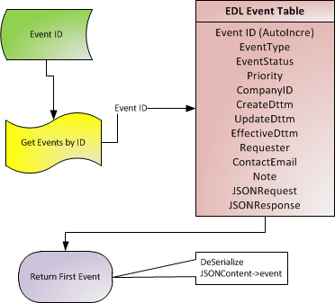
EDL Event Management
Search events and get the event ID list based on the criteria
Get events based on event ID list
Display and manage the events through web UI

Slide 8
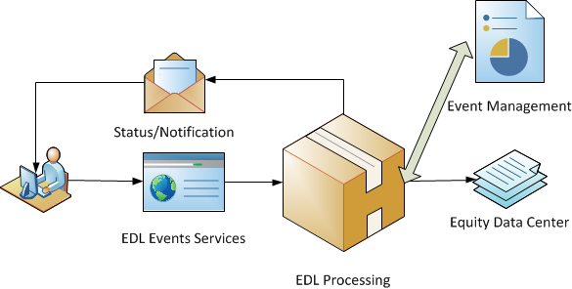
EDL Event Status and Notification
Submit request through event services
Get the unique event ID for the request
Receive the asynchronized notification with the status of the event

Slide 9


